Slide 1
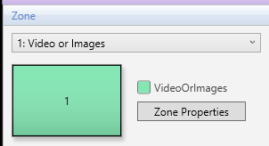
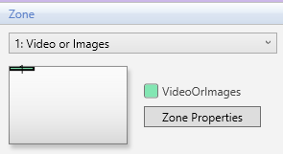
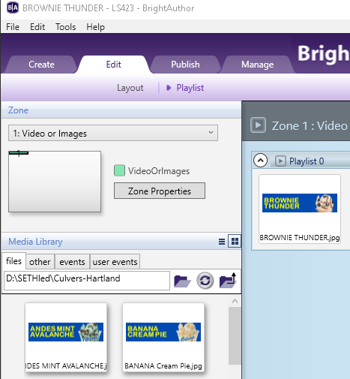
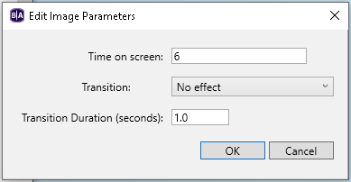
BrightAuthor Quick Start Guide
262-443-1864
www.sethled.com
Pick the Images You Want on Your Sign
1
Start BrightAuthor
In the Windows Start Menu, Click on BrightSign and Select BrightAuthor
2
Click on the Edit tab
There are two sub-tabs below Edit (Layout & Playlist) – Make sure you have Playlist selected.
3
Click on the File Menu ⇨ Open Presentation
Navigate to Your Sign Folder (On Desktop) to Open Your BrightAuthor Template file.
Click on the Filename with the word “Template” in the name and Click on the Open Button
You should see a small Green Box in a larger White Box (in the upper left side of the App)
NOTE: If you see a solid Green Box (with a 1 in the middle), then your Template File is not open. It should be a small green box in the upper left corner of the application.
Make Sure You Have Your Media Library Pointing to the Sign Folder on Your Desktop (that is where all your Images are Located)
If you don’t see your images in the lower right side of the App, click on the and select your Sign Folder and click on the OK Button, otherwise go to Step 5.
4
5
Drag the Images to the Playlist Panel
Click on the Image in the Media Library panel and Drag it to the Playlist panel
NOTE: You can rearrange images in the Playlist by Dragging them to a different position in the Playlist Panel
NOTE: You can delete images from the Playlist (not your Sign Folder) by clicking on the image in the Playlist and pressing the Delete Key on the Keyboard.
NOTE: You can specify how long you want an image to show on the Sign by double clicking the image in the Playlist and change the “Time on Screen” (seconds) and Press OK Button.
1 of 2
Click on Schedule Menu ⇨ New
Click on Schedule Menu ⇨ Save As & Name Your Schedule (e.g., February-2017) &
Press
4
Click on Schedule Menu ⇨ Save As
Enter Name for Your Schedule (e.g., February-2017) & Press
5

Slide 2
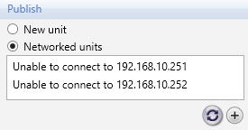
BrightAuthor Quick Start Guide
262-443-1864
www.sethled.com
Display the Images on the Sign (Using Network)
6
Click on the Publish tab
There are multiple sub-tabs below Edit (Local Storage, etc.) – Make sure you have “Local Network” selected to be able to Publish over the Network
7
Click on the Sign Name (Left Side of Screen)
Click on the Sign Name for your Sign on the Left Side of the Application
Culvers-Sign
8
Click on the Publish Button
Click on the Publish Button in the Publish to panel (Lower Left Corner of the App). The App will show you Publishing Progress click on the Done Button when it is Complete.
9
Look at Sign to Ensure Content is on Sign
Look at the Sign to ensure that your desired content is on the Sign. Repeat steps2-9 if necessary.
2 of 2
Start BrightAuthor
Click on , Click on A, Click on B, Click on BrightSign, Click on BrightAuthor
1
Start BrightAuthor
Click on , Click on A, Click on B, Click on BrightSign, Click on BrightAuthor
1
5
2
Click on Publish Tab
2
Click on Publish Tab
3
Click on Schedule Menu ⇨ New
Click on Schedule Menu ⇨ Save As & Name Your Schedule (e.g., February-2017) &
Press
3
4
Click on Schedule Menu ⇨ Save As
Enter Name for Your Schedule (e.g., February-2017) & Press
5

Slide 3
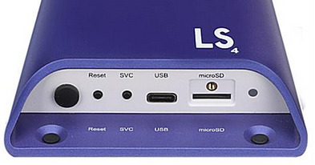
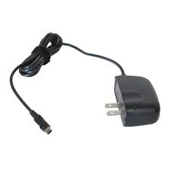
BrightAuthor Quick Start Guide
262-443-1864
www.sethled.com
Display the Images on the Sign (Using SD Card)
6
Click on the Publish tab
There are multiple sub-tabs below Edit (Local Storage, etc.) – Make sure you have “Local Storage” selected to be able to Publish to SD Card
7
Remove the SD Card from the BrightSign Device (Purple Box)
Push the SD Card and remove it from the BrightSign Device.
8
Put your SD Card in the Computer
Put the micro-SD Card into the SD Card Holder and push into your Computer’s SD Card slot.
9
Select your SD Card Drive
Click on the Browse Button in the Publish to panel (Left Side of the Screen). Navigate to and select your SD Card and press the OK Button
10
Click on the Publish Button
Click on the Publish Button in the Publish to panel (Lower Left Corner of the App). The App will show you Publishing Progress click on the Done Button when it is Complete.
11
Put SD Card into BrightSign Device (Purple Box)
Push the SD Card securely into the BrightSign Device.
12
Reboot the BrightSign Device
Pull the Power Cord out from the Outlet and Plug it back in to Reboot.
NOTE: It takes approximately 30-40 seconds before you should see an image.
2 of 2
Start BrightAuthor
Click on , Click on A, Click on B, Click on BrightSign, Click on BrightAuthor
1
Start BrightAuthor
Click on , Click on A, Click on B, Click on BrightSign, Click on BrightAuthor
1
5
2
Click on Publish Tab
2
Click on Publish Tab
3
Click on Schedule Menu ⇨ New
Click on Schedule Menu ⇨ Save As & Name Your Schedule (e.g., February-2017) &
Press
3
4
Click on Schedule Menu ⇨ Save As
Enter Name for Your Schedule (e.g., February-2017) & Press
5

